Slide 1
Introduction to Wide Area Networks (2)

Slide 2
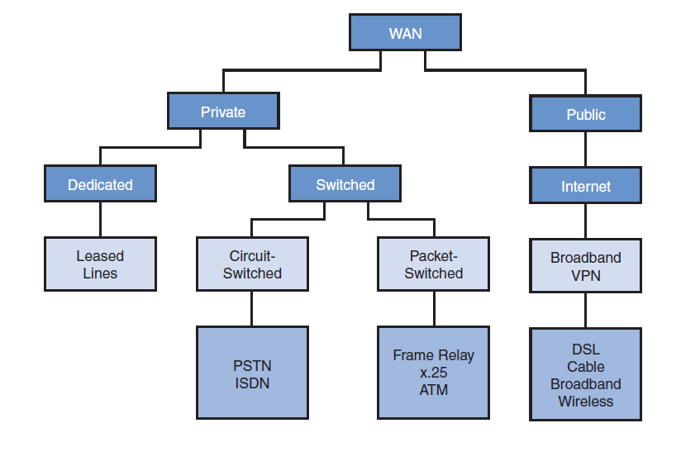
Overview of Connection Options

Slide 3
Reasons for Packet Switching
Makes more efficient use of the BW
Resources are only used when needed
No requirement for setting up a circuit from sender to receiver
Packet switching has no problem with handling messages of different lengths
Although packet switching was designed for data transmission it copes very well with QoS requirements
Packet switching is becoming faster, cheaper and more ubiquitous. In the near future it will probably replace all circuit switched technologies

Slide 4
Packet Switched Technology
X.25
Frame Relay
ATM (Uses fixed length Cells)
xDSL (x = H, S, A, V variants of the DSL link)
Cable Modem
PVNs
Wireless

Slide 5
X.25 Connection
Developed in 1970s (one of the first implementations of packet switching)
Works with a set of protocols developed by ITU (Layer 3 OSI model)
Uses a great deal of error checking due to the unreliable nature of the infrastructure then
Possible speeds quoted as up to 64kbps
The predecessor of Frame Relay
Packets vary in length

Slide 6
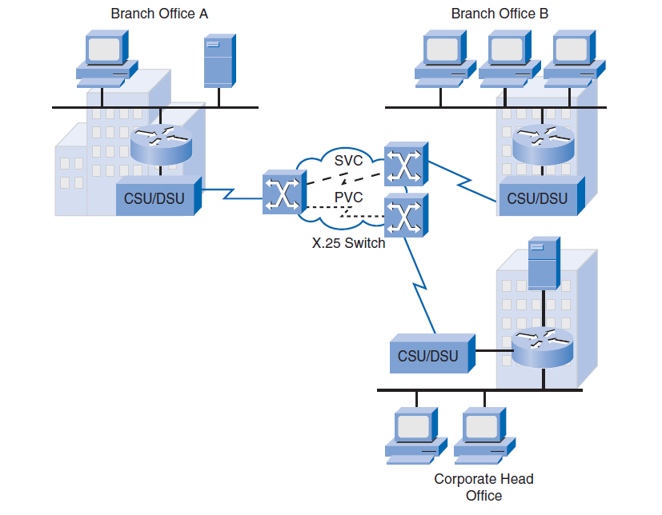
The X.25 Connection

Slide 7
Frame Relay
An advancement of the X.25 technology designed for faster communications
Takes advantage of the low error higher performance of the infrastructure now in place
Packets are called frames
Speeds are 56kbps to 1.544Mbps
Frames vary in length
Makes use of DLCIs for routing. These act as road signs to the travelling frames (Data Link Connection Identifier)

Slide 8
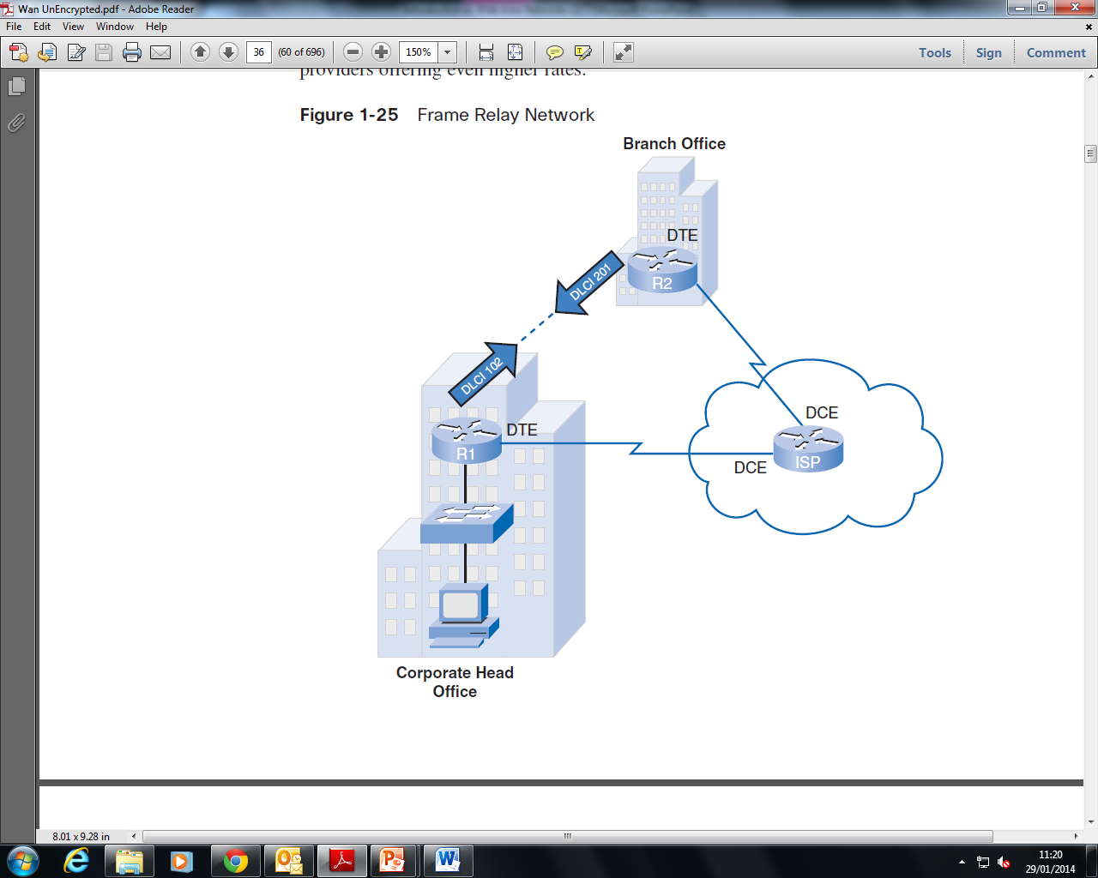
Frame Relay Connection

Slide 9
ATM Connection
Asynchronous Transfer Mode
High speed connection capable of delivering data, voice and video simultaneously
Uses fixed sized Cells (53 bytes) as opposed to variable size packets or frames
Speeds have been claimed up to 622Mbps !!!
Predicted to take over all previous technologies in the future

Slide 10
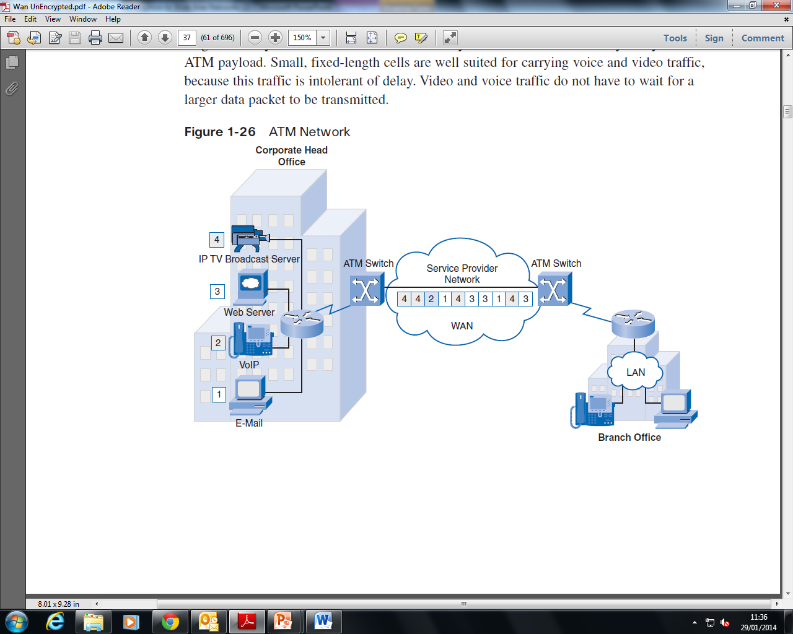
ATM Connection

Slide 11
xDSL Connection
Digital Subscriber Line
Comes in different flavours (x = H, S, A, V) each with its own characteristics
Exploits the extra BW of the cat 3 cable used for the telephone local loop without disturbing voice data. Small low pass filters are used
The ADSL type is used extensively for home internet broadband connection.
This is a distance sensitive technology. As the distance to the CO increases then the signal quality and the speed decrease

Slide 12
Typical xDSL Speeds
Common DSL Technologies and Attributes
Technology | Speed | Distance | Simultaneous Voice and Data | Where to use
HDSL (High-rate DSL) | 1,544Mbps (2pairs) 2,048Mbps (3 pairs) | 100 - 3000 m | No | Instead of T1/E1 for Internet; LAN & PBX;
SDSL (Symmetrical DSL) | 1,544Mbps or 2,048Mbps (1pair) | 100 - 7000 m | No | Instead of T1/E1 for Internet; LAN & PBX; VoIP
ADSL (Asymmetrical DSL) | 1,544 – 8,448 Mbps for downstream and 640 - 1,544 Kbps for upstream | 100 - 5000 m | Yes | Internet, Intranet, VPN, video on demand, VoIP
VDSL (Very-high-rate DSL) | 12,96-51,84Mbps for downstream and 1,6 – 2,3 Mbps for upstream | 100 - 1500 m | No | Access to multimedia resources; HDTV

Slide 13
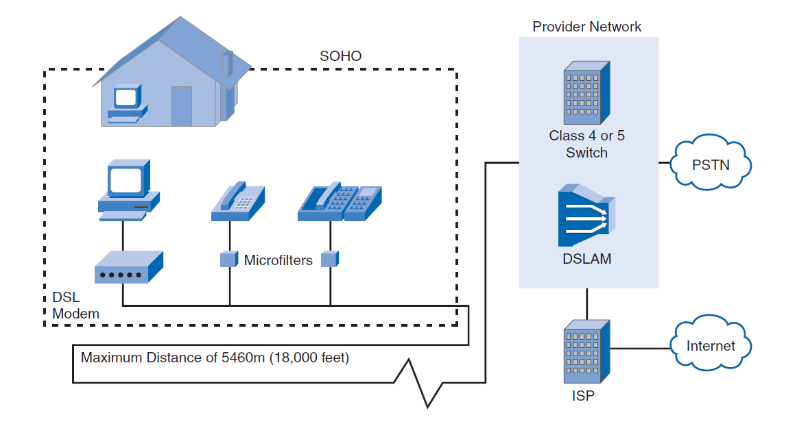
Typical ADSL Connection

Slide 14
Cable Modem Connection
Another popular method of providing an internet broadband connection
Became available through cable TV suppliers
Connection speed is typically 30Mbps for download and 3Mbps for upload. (Another Asymmetrical connection)

Slide 15
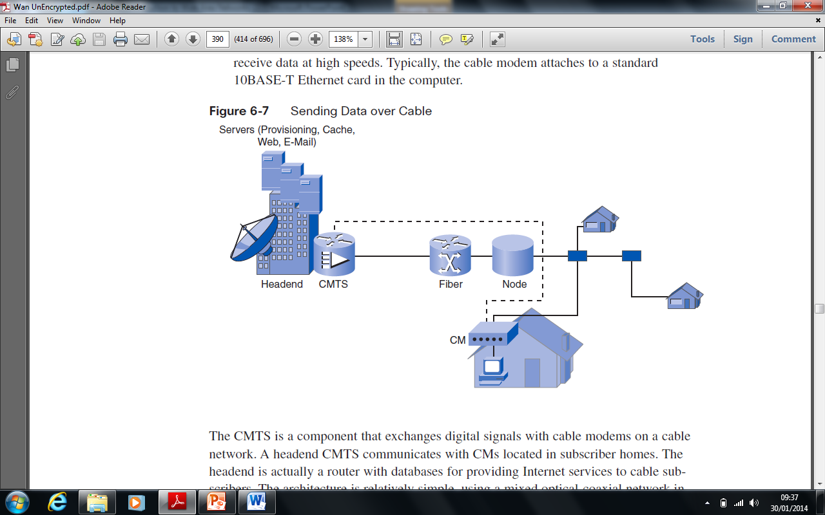
Cable Modem Connection

Slide 16
VPNs (Virtual Private Networks)
Why do we need VPNs?
VPNs allow for the communication of sensitive data within the public internet. The data is usually encrypted
The internet is a worldwide, publicly accessible IP network that has become an attractive cheap way to interconnect remote sites.
However, the fact that it is a public infrastructure poses security risks to enterprises and their internal networks.
Fortunately, VPN technology enables organizations to create private networks over the public internet infrastructure that maintain confidentiality and security.
VPNs allow employees to telecommute by providing access to their employers intranet

Slide 17
The Protocols in a VPN
The data paths are called tunnels
Two tunnelling protocols in common use are PPTP (Point to Point Tunnelling Protocol) and L2TP (Layer 2 Tunnelling Protocol)
These protocols provide for a secure connection

Slide 18
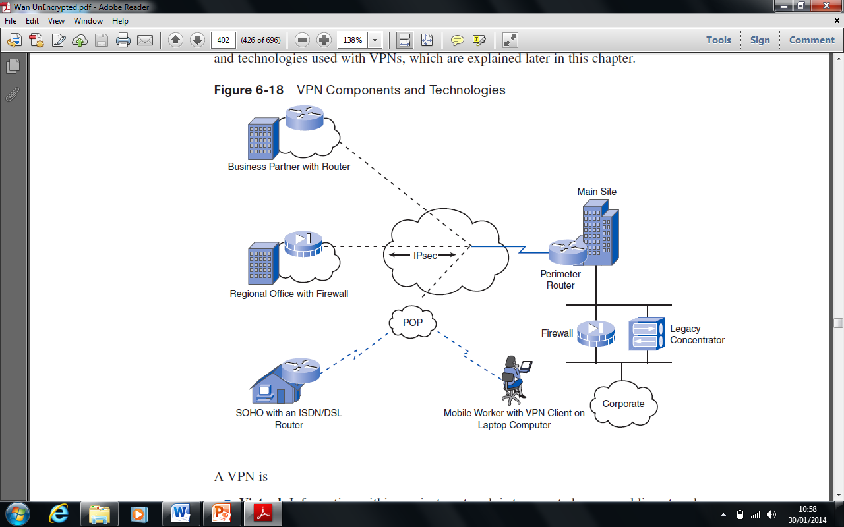
VPN Connection
POP - Point of Presence (A connection point to the WAN service)

Slide 19
Wireless Connection
Wireless networking complies with the IEEE 802.11 wireless local area network (WLAN) standard, which addresses the 5-GHz and 2.4-GHz public (unlicensed) spectrum bands.

Slide 20
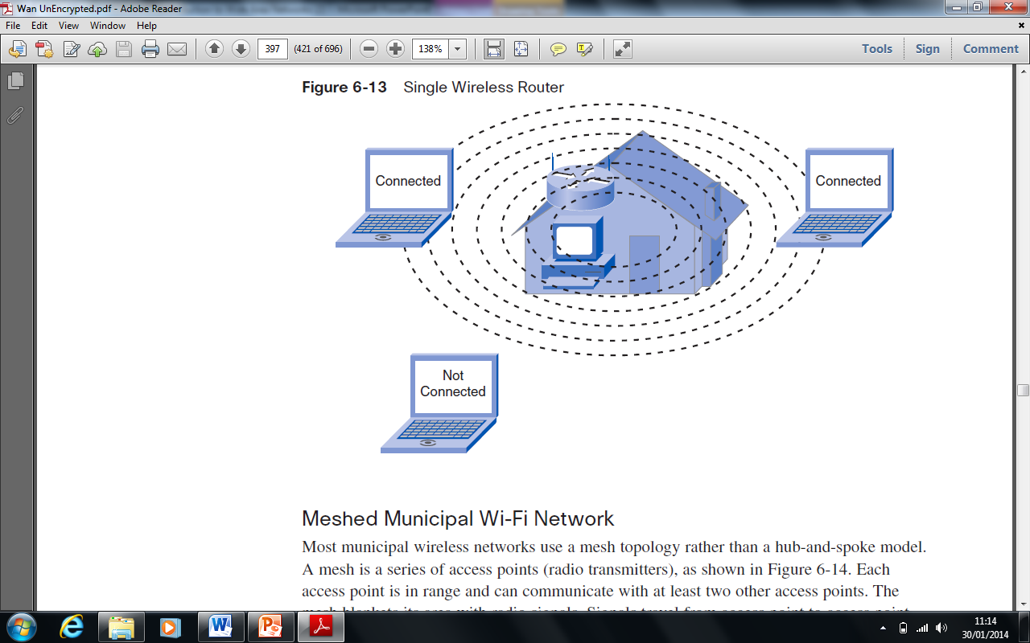
A Single Wireless Router

Slide 21
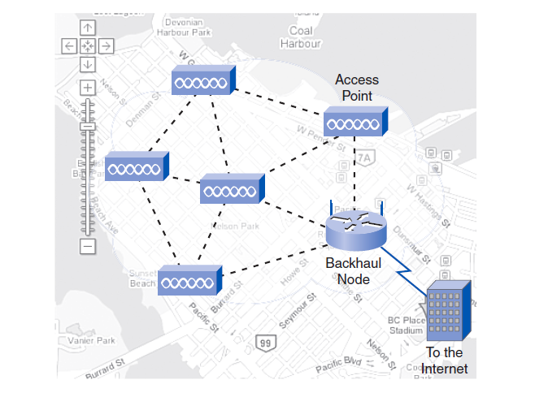
A Mesh Network
How it Works
A series of radio transmitters (access points) each in range with at least another 2 transmitters.
This effectively blankets the area with a wireless signal.
This provides a hotspot area
Signals travel from access point to access point within the mesh towards the internet

Slide 22
Other WAN Protocols in Common Use
MPLS
Multiprotocol Label Switching. This is a routing protocol that makes use of labels inserted into the frame to speed up transmission. It can be used in all WAN connection types
SMDS
Switched Multimegabit Data Service. Used in Cell Switching
HDLC
High Level Data Link Control. Further encapsulates the data within frames for transmission over the WAN

Slide 23
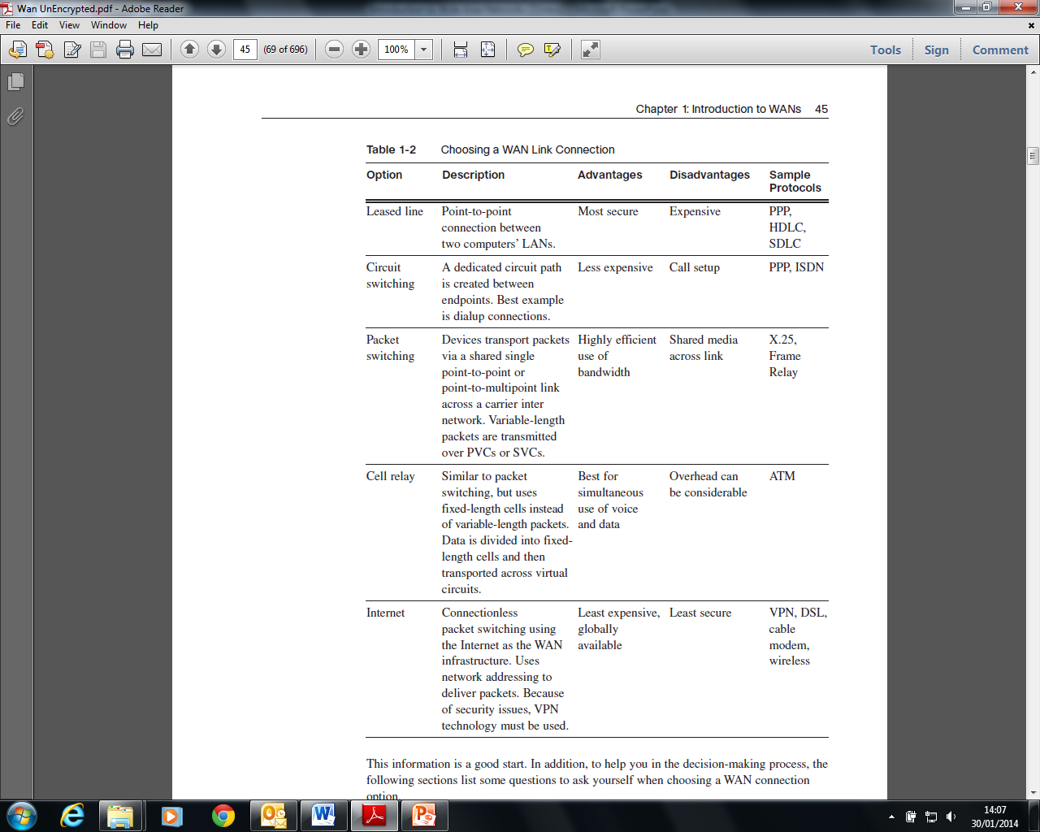
In Summary

Slide 24
In Summary (cont)

